Slide 1

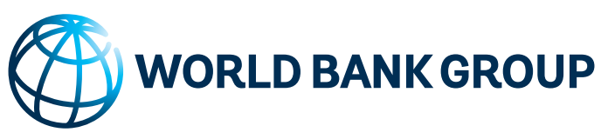
Quantifying the Impacts of underheating in Georgia

Slide 2
Objective of the Assessment
The overall objective of the activity is: to estimate the economic, social, and financial costs of under-heating in buildings in Georgia.
The assessment includes:
direct and indirect immediate and long-term negative effects on health, education, economic and social activity of the population;
the economic costs of underheating public, commercial, and residential buildings; and
an analysis of the health-related costs stemming from energy inefficient buildings and poor indoor environment conditions beyond temperature such as air quality, notably smog from heating/lack of ventilation and mold from condensation in cold walls.

Slide 3
Why is underheating an issue in Georgia?
The country’s central heating system stopped operation in the early 1990s and was gradually dismantled in early 2000;
Soviet-era blocks of flats were not designed for individual heating systems;
In rural and some urban residential buildings, only selected rooms are fully heated; the rest are closed during the cold season;
Due to the high price of gas, wood remains the main source for heating for the majority of rural residences;
Some rural schools heat only a single classroom during class hours and the open fire stoves are a hazard in the poorly ventilated classrooms.

Slide 4
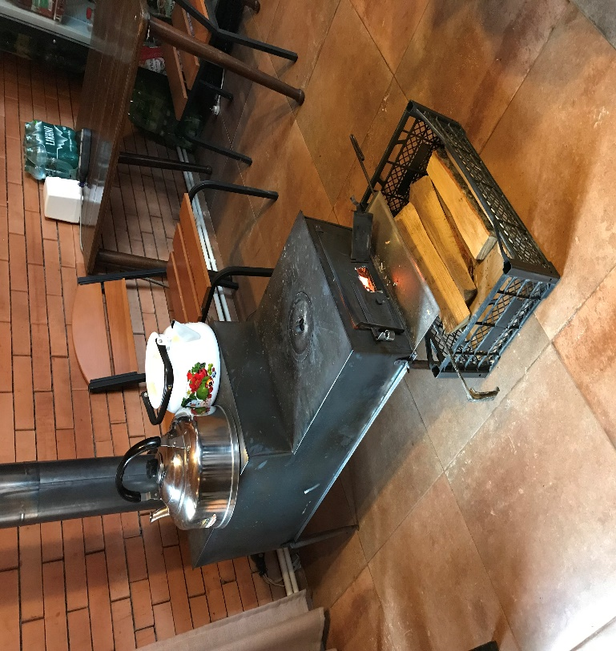
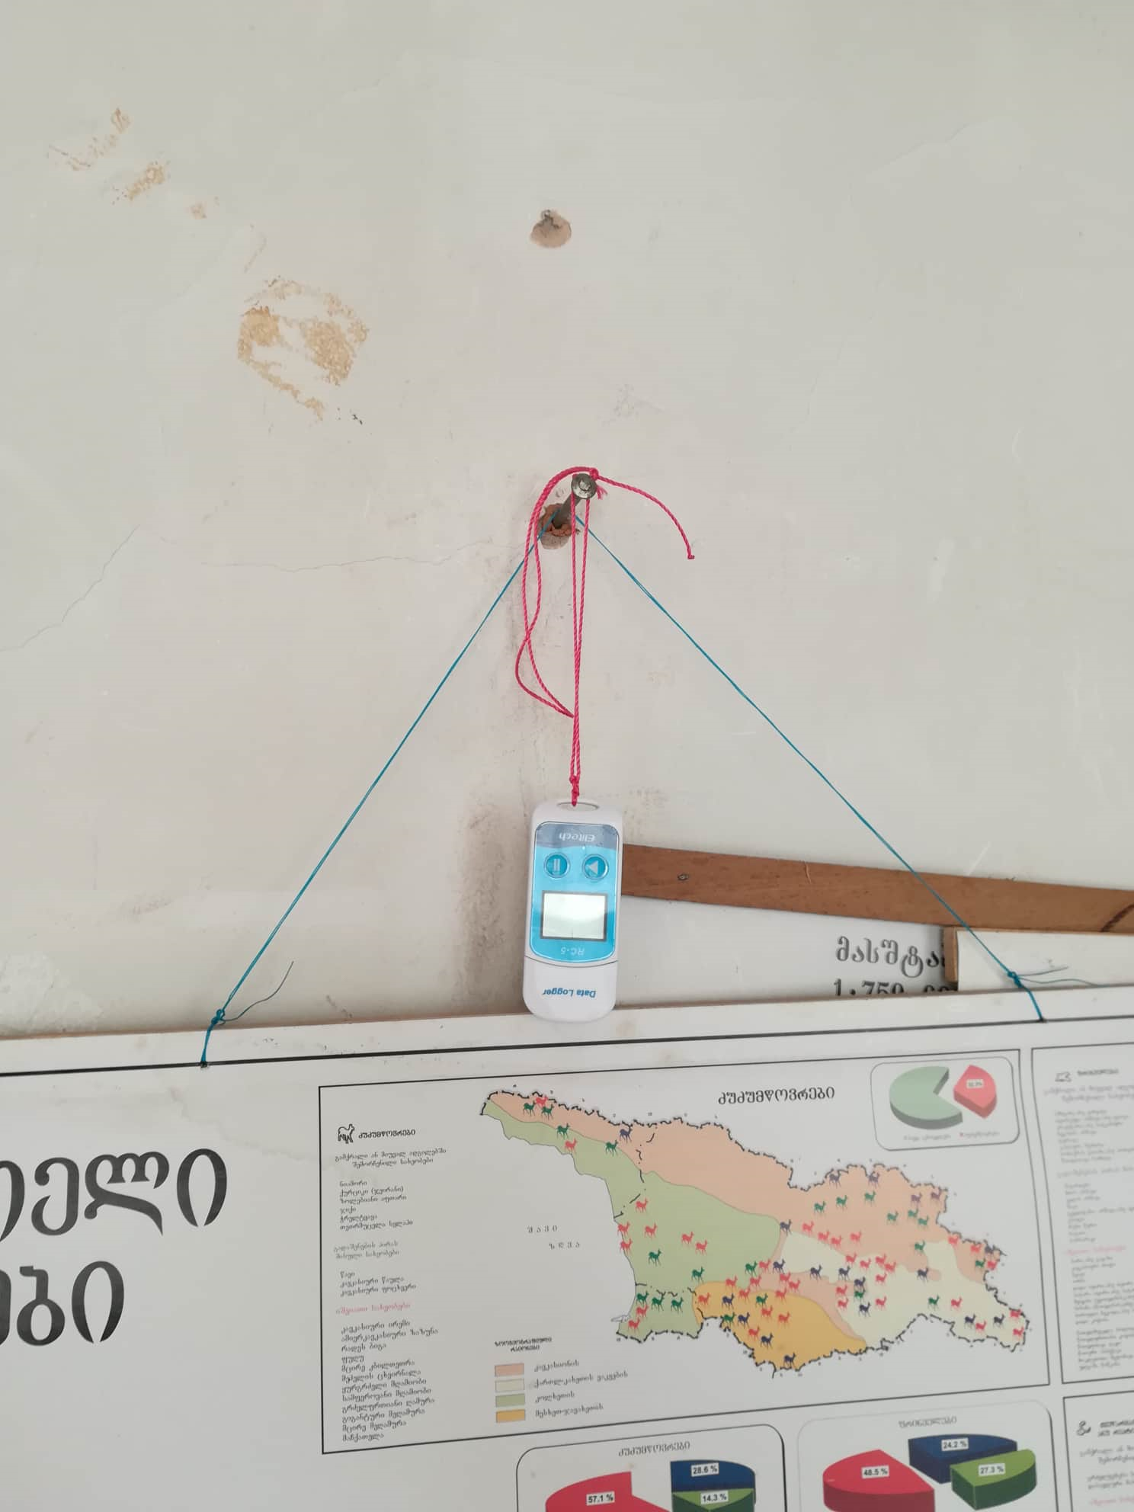
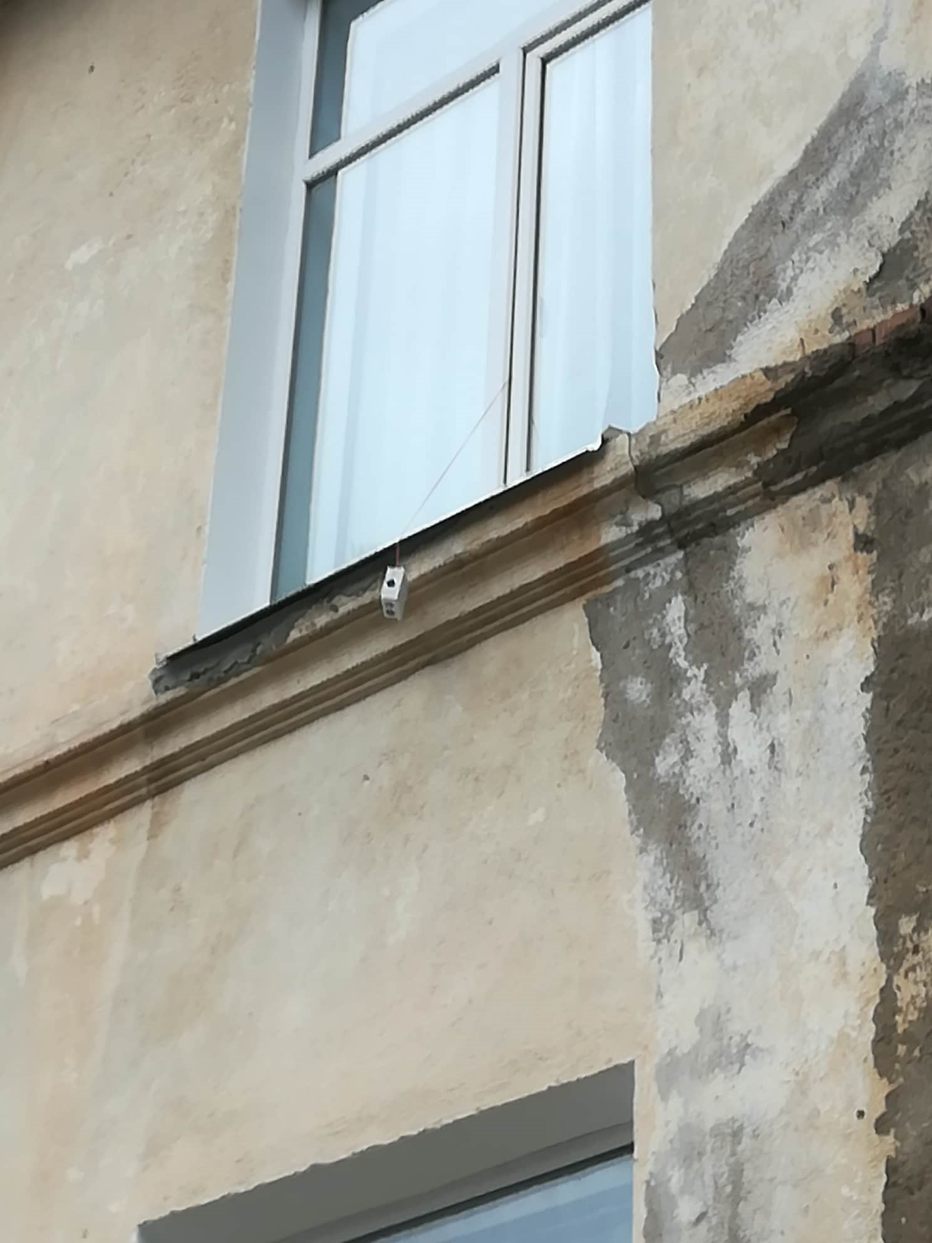
Survey and Analysis
Stage One
Conducted 1,474 key informant interviews
Stage Two
Measured indoor and outdoor temperatures
Recorded housing characteristics
Surveyed 482 households and 227 organizations
Conducted the survey over 2-3 weeks during February –March 2019
Installed 994 temperature loggers
Stage Three
Estimated cold-related excess mortality
Estimated economic cost of excess mortality

Slide 5
Underheating in Households

Slide 6
Description of Dwellings in Georgia
Total Number of Rooms in the Dwellings
Types of Dwelling

Slide 7
Insulation of Dwellings
Presence of Roof Insulations
Presence of Wall Insulation
A significant number of households living in apartments and detached homes have not renovated or retrofitted their homes so as to contain heat and provide thermal comfort during the winter season

Slide 8
Type of Energy Used by Households
Types of Heating Energy Used
Household Profile by Source of Heating Energy
 | Cash Income per Month | Age of Household Head | All Household Members | Number of Adult Members | Number of Children < 18 Yrs old
Biomass | 3,439 | 63 | 3.4 | 2.6 | 0.78
Valid N | 680 | 680 | 680 | 680 | 680
Natural Gas | 4,368 | 55 | 3.5 | 2.7 | 0.90
Valid N | 640 | 640 | 640 | 640 | 640
Electricity | 4,637 | 56 | 3.4 | 2.6 | 0.9
Valid N | 120 | 120 | 138 | 14 | 522
Number of Hours that Firewood Heating is on
Traditional firewood heating stoves used by many households in Georgia are considered inefficient and emit a certain level of harmful smoke

Slide 9
Indoor and Outdoor Air Temperature
Average Hourly Indoor and Outdoor Air Temperature of all Households
Average Hourly Indoor and Outdoor Air Temperature for Households in Tbilisi, Other Urban, and Rural Areas
Average Hourly Indoor Air Temperature of Households Living in Soviet Era Apartments and Detached Homes

Slide 10
Indoor and Outdoor Air Temperature
Average Hourly Indoor Air Temperature of Households Using Firewood Heating Stove Only Versus Households Using Natural Gas Space Heaters Only
Average Hourly Indoor Air Temperatures by Thermal Insulation of Walls and Roof

Slide 11
Underheating in Public Schools and Preschools in Georgia

Slide 12
Building Stock of Public Schools
Public School Building(s) by Year Constructed
Source: Public School Survey, Fall 2018

Slide 13
Type of Heating Used in Public Schools

Slide 14
Average Air Temperature Inside Classroom and Outside School Building
Central Heating System VS Firewood Heating Stoves

Slide 15
Number of Students Wearing Coats in the Classrooms During the Winter Months
 | Central Heating & Central Heating Plus Individual Heating Appliances | Firewood Heating Stoves & Firewood Heating Stoves Plus Individual Heating Appliances | Electric Heat Pump, Space Heater & Natural Gas Space Heater | All
No | 86% | 70% | 25% | 75%
Yes | 14% | 30% | 75% | 25%
Total % | 100% | 100% | 100% | 100%
# all schools | 72 | 124 | 4 | 200

Slide 16
Social Impact of Underheating

Slide 17
Copying Strategy of Underheating
Adequate heating and affordability of heating is a concern across the Europe and Central Asia (ECA) region
Qualitative research in eight ECA countries shows that households often resort to coping strategies that are harmful to their overall wellbeing, including education, nutrition, health, and social integration.
Prevalent coping strategies include:
Cutting spending on food (especially meat and proteins);
Heating only one room in the house during winter for the whole family and extended family;
Avoiding doctor visits and buying medicines; practicing self treatment;
Saving on clothing, travel, transportation, child care, and telephone use;
Avoiding social gatherings (weddings, celebrations) and not inviting guests at home;
Avoiding having to spend time at home.
Urban and rural households have different sources of vulnerability when it comes to adequacy and affordability of heating: urban residents are less able to switch to cheaper fuel sources.
Rural and semi-urban households are more likely to experience impacts from indoor air pollution, and have difficulty to afford fuels for the winter.
Notes:
Source: 2013-2014 studies in Armenia, Belarus, Bulgaria, Croatia, Kyrgyz Republic, Romania, Tajikistan, Turkey including 208 focus group discussions. World Bank (2015) “Adapting to Higher Energy Costs: Findings from Qualitative Studies in Europe and Central Asia”

Slide 18
Quantifying the Health Impact of Underheating

Slide 19
Health Impacts of Cold
The impact of cold weather on health is predictable and mostly preventable.
Direct effects₁ | Indirect effects₁ | Costs
Heart attacks and other cardiovascular diseases Stroke Respiratory disease Falls and injuries Hypothermia | Mental health conditions e.g. depression Carbon monoxide poisoning from poorly maintained or poorly ventilated boilers, cooking and heating appliances and heating | Cold homes cost the UK NHS £850m per year - £6bn to fix - 7 year payback₂ $12,500 per case of a cold related hospital stay in US₃
1. PHE. 2017 2. BRE 2010 3. Merril et al 2008

Slide 20
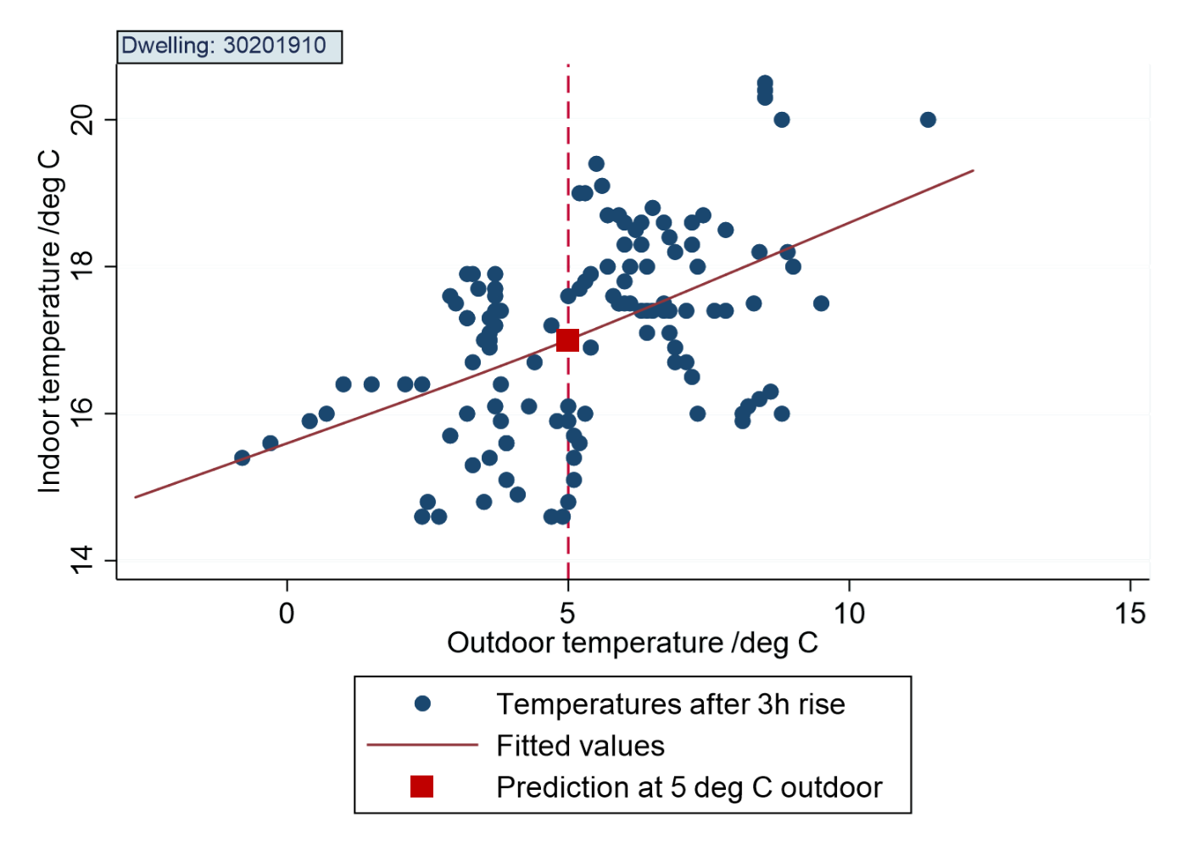
Notes:
Process to develop SIT
Regression of indoor on outdoor temperature
Use indoor temperature data only after 3 hours of no 1 hour dip >0.1
Prediction at 5ºC outdoor temperature
Generation of meta-data (dwelling SIT)

Slide 22
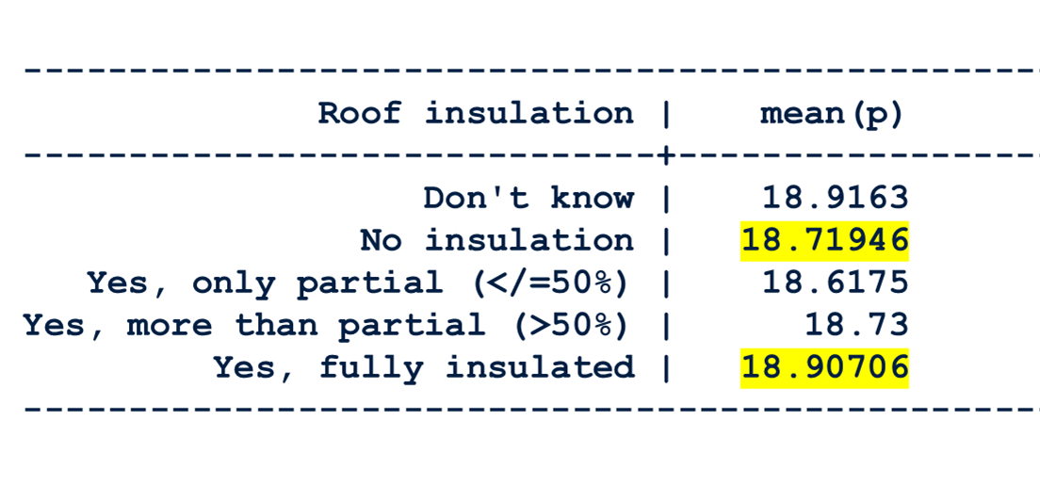
More energy efficient
Reducing cold impacts
Household characteristics
Outdoor temp
Indoor temp
Health outcome
Less energy efficient
Increasing cold impacts
Notes:
Results from Georgia are consistent with multi-country meta analysis
then explain slide

Slide 23
Mortality Associated with a 1deg Decrease in Temperature
Source: Analitis et al, AJE 168(12)
Notes:
400k per year

Slide 24
Temperature Related Mortality Risk
All cause
CVD
Respiratory
Cerebrovascular
Source: Analitis et al, AJE 168(12)

Slide 25
Temperature related mortality risk
Source: Gasparrini et al, Lancet 2015; 386: 360-75

Slide 26
Relationship Between Outdoor Temperature and Mortality
Daily deaths in Georgia (blue dots) and maximum temperature (green dots) based on Tbilisi weather station, 2015 to 2018. Red line indicates the fitted values of the seasonal variation

Slide 27
Regression-based estimate (blue line) and 95% confidence interval (grey shading) of the relative risk of all-cause mortality in relation to daily maximum temperature at lags 0 to 13 days based on the previous analysis

Slide 28
Calculation of Value of Statistical Life (VSL) in Georgia in US$ 2017
Using mean from study of OECD countries as the base, from OECD 'Meta-analysis of Value of Statistical Life estimates’ Following Narain and Sall (2016) | 2011 VSL base (2011$ PPP) | 2011 PC GDP base (2011$ PPP) | 2011 PC GDP Georgia (2011 PPP$) | Elasticity of VSL with respect to income (Y) (assumption) | 2017 VSL Georgia (2011 constant $, PPP adjusted) calculated | Ratio VSL/Y | 2017 VSL Georgia (current US$)
 | 3,832,843 | 36,839 | 7,545.97 | 1.4 | 686,905.1 | 71 | 286,404
 | 3,832,843 | 36,839 | 7,545.97 | 1.5 | 607,528.2 | 63 | 253,308
 | 3,832,843 | 36,839 | 7,545.97 | 1.6 | 537,323.8 | 55 | 224,036
Source for economic data: World Bank, World Development Indicators
We have selected $253,308.34 as the Value of Statistical Life that will be used to calculate the economic cost of mortality attributable to under-heating. All estimates shown here pass the main robustness test, which is VSL/Y between 55-75. The value, $253,308.34, is chosen as the middle estimate.

Slide 29
Economic value of Mortality in Georgia attributable to Underheating - ~3.5% of GDP
Year | Deaths | Attributable to cold | Economic cost of cold related deaths in 2017$, using VSL= $253,308.34 | Share of 2017 GDP (%)
2016 | 50597 | 2589.1 | 655,840,629 | 4.349
2017 | 47822 | 2219.3 | 562,167,204 | 3.728
2018 | 46524 | 1862.1 | 471,685,464 | 3.128
Based on mortality calculations in “Assessment of the potential impact of home energy efficiency improvements on winter indoor temperature and health, Georgia” by Shakoor Hajat and Paul Wilkinson. London School of Hygiene & Tropical Medicine, June 2019
GDP numbers taken from World Bank, World Development Indicators ($ 15,081,338,092 in 2017)

